Slide 1
Enhancing Indo-Bangla Waterways Connectivity
November 2016
Ranjit Barthakur
Chairman
FICCI North East Advisory Council

Slide 2
In this presentation
Slide 3 Historical Context
Slide 4 Connectivity Hub of the future
Slide 5 - 6 Current Status of IWT
Slide 7 – 8 The IWT Potential
Slide 9 – 16 IWT Connectivity with Bangladesh
Slide 17 - 24 Integrated Development Approach

Slide 3
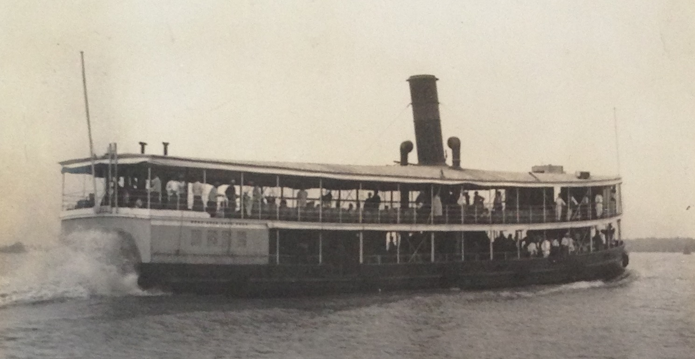
Historical Context
The first fleet of Country Boats for carrying goods between Assam and Bengal was started in 1839, by Assam Company Limited
The first steamboat “THE ASSAM” was introduced in 1841
The River Steam Navigation Company started regular steamer services between Kolkata and Assam in 1863
Partition in 1947 resulted in a major set back for IWT connectivity
The Earthquake of 1950 resulted in change of course of the river and made the river shallower – A major set back for Navigation
The out Break of war with Pakistan in 1965 Brought River Navigation through East Pakistan to a complete halt
In 1972 the first protocol on inland water transit and trade was signed between India and Bangladesh.

Slide 4
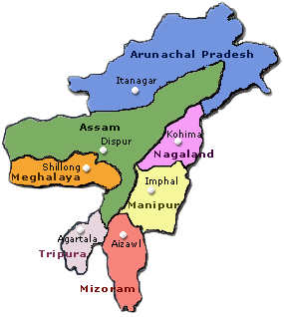
CONNECTIVITY HUB OF THE FUTURE
China
Connecting With
Mainland India
Bhutan
Myanmar
Bangladesh
Inland Waterways can play a major role in providing connectivity Between North East India, Bangladesh and ASEAN

Slide 5
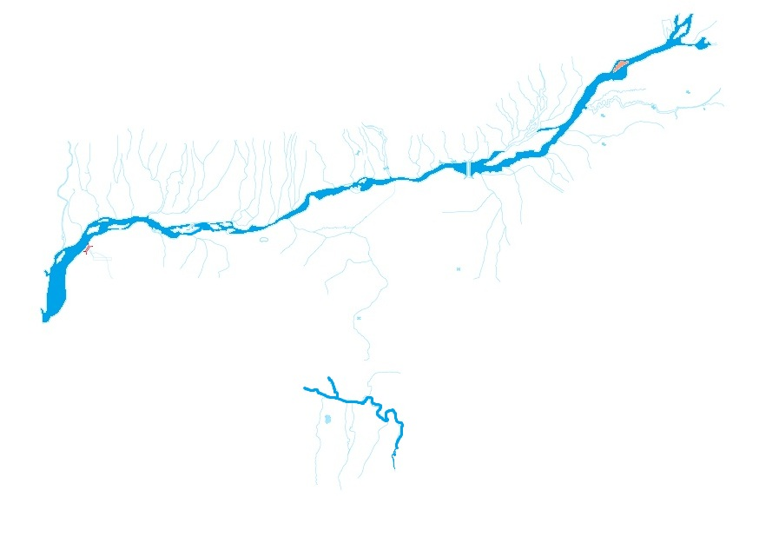
Current Status of IWT
The north east region of India has 18 of the national waterways in India
Brahmaputra (NW2) and Barak (NW6) are the two national waterways in the region
However at present both NW2 and NW6 lacks adequate draft for year round navigation
In the entire region, there is only one IWT terminal (Pandu, Assam) which meets the requisite criterion of a terminal
Moreover protocol route issues with Bangladesh needs to be resolved
NW – 2, (protocol route 1 in Bangladesh). Overall length of 891 km from Dhubri to Sadiya
The sector requires significant physical infrastructure development
NW – 16, (protocol route 2 in Bangladesh). Overall length of 121 km in India from Lakhipur to Bhanga

Slide 6
Current Status of IWT in NE India
Due to the inadequate infrastructure, the IWT has so far remained underexploited
In 2011 – 12 out of the total cargo movement of ~ 91 MTPA in Assam, IWT contributed a meager 2.4 MTPA
In Assam the contribution of IWT to the overall cargo movement stands at less than 3% where as in Germany and Bangladesh it stands at 20% and 32% respectively
IWT’s share of the total cargo movement of north east is almost negligible

Slide 7
The IWT Potential
Given its advantage over other mode of transports, the sector should be exploited
Low Capital Cost
It has been estimated that development of inland waterways cost a mere 5 – 10% of the cost of developing an equivalent 4-lane highway or railway
Low Fuel Cost
Fuel consumption by inland waterway sat 4.83 gm/tonne-km is just 15% and 54% of fuel consumption by road and railways respectively
Low Maintenance Cost
Cost of maintenance of inland waterways is 20% of that of a road of equivalent capacity
Low Carriage Cost
Carriage cost by shipping stands at just 21% and 42% of cost by road and railways of equivalent capacity respectively
External Costs
External Costs such as accidents, noise pollution, air pollution, climate change, etc are also significantly lowered to rail and road. In the European Union the marginal costs of water transport have been estimated at 20.7% and 40.5% of roadways and railways respectively

Slide 8
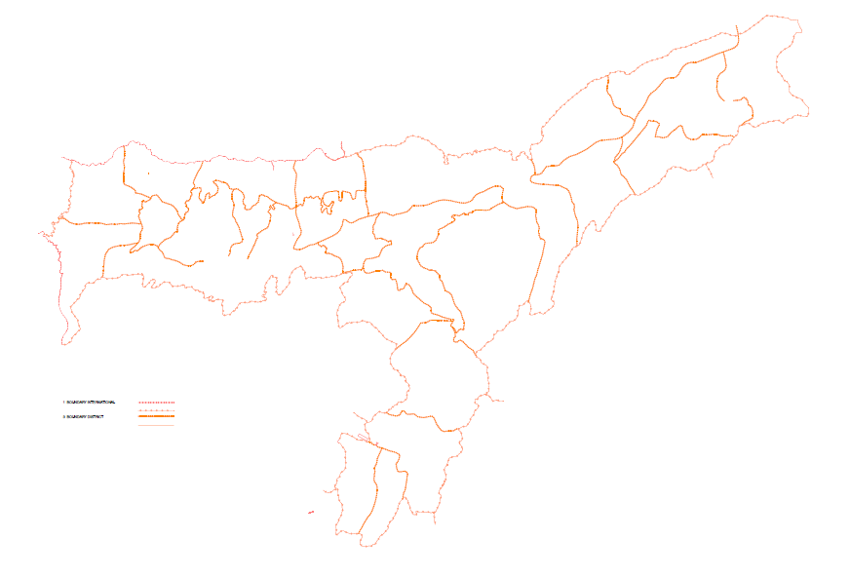
The IWT Potential
Even with multimodal transport/transhipment the overall total logistics cost by IWT is lower than by road and railway modes of transportation
4. Transhipment of cargo from IWT to Road - Terminal Handling at Pandu and transfer to ICD Amingaon
2. Transhipment of cargo from road to IWT - Terminal Handling
3. IWT transportation leg
1. Cargo from Origin to IWT terminal in upper Assam via road
5. Rail movement from ICD Amingaon to Haldia port
Transport via IWT is expected to results in cost savings to the tune of USD 14.5 – 17 / ton

Slide 9
IWT Connectivity with Bangladesh

Slide 10
Pandu Port
Tezpur
Neamati
Dhubri
Farakka
Sirajganj
Narayanganj
Kolkata
NW-1
Khulna
Karimganj
Mowgla
Haldia
Fenchuganj
Chandpur
Saugar Anchorage
10
10
ORISSA

Slide 11
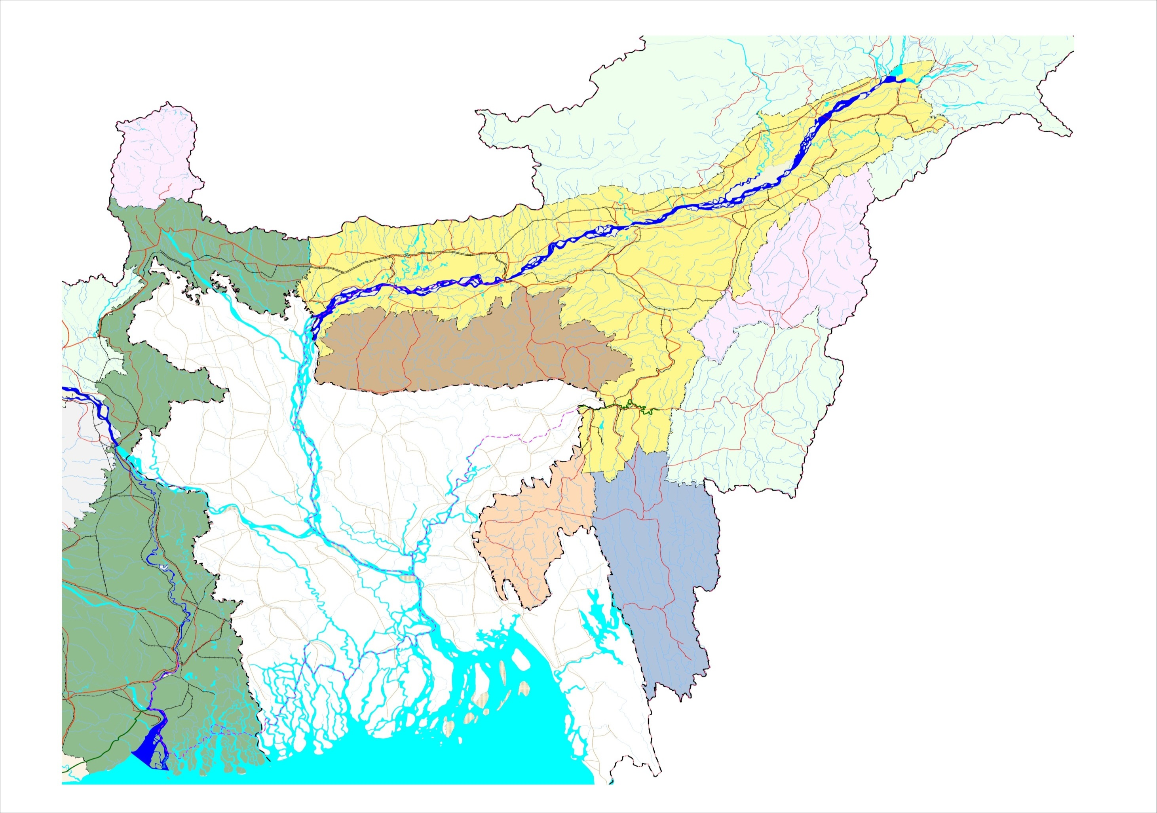
NAGALAND
INDO – BANGLADESH
PROTOCOL ROUTES
JOGIGHOPA
DISPUR
37
31
PANDU
DHUBRI
37
P
40
KOHIMA
DAIKHAWA
SHISHUMARA
SHILLONG
31
51
M E G H A L A Y A
BIHAR
CHILMARI
53
Ganga R.
Barak
MANIPUR
34
BAHADURABAD
Surma R.
ZAKIGANJ
LAKHIPUR
SYLHET
BHANGA
P
53
IMPHAL
Myanmar
JHARKHAND
Jamuna R.
Kusiyara R.
KARIMGANJ
MARKULI
FENCHUGANJ
B A N G L A D E S H
SHERPUR
DHULIAN
GODAGARI
SIRAJGANJ
AJMIRIGANJ
RAJSHAHI
P
54
N
Ganga R.
Baral R.
BHAIRAB BAZAR
ASHUGANJ
44
BAGHABARI
Meghna R.`
TRIPURA
ARICHA
AKHAURA
AGARTALA
AIZWAL
Bhagirathi R.
DHAKA
AGARTALA
MIZORAM
NW-1
NARAYANGANJ
P
Padma R.
Legend
2
Declared National waterway
Proposed National waterway
Protocol route
Road
Rail
NH
CHANDPUR
35
KHULNA
P
BARISAL
WEST BENGAL
Meghna R.
CHALNA
KAUKHALI
51
KOLKATA
P
Protocol route distances
6
P
MONGLA
41
Kolkata - Guwahati/Pandu ...... 1535 km
Kolkata - Karimganj...................1318 km
Dhulian-Rajshahi...........................78 km
HALDIA
P
ANGTIHARA
Hooghly R.
NAMKHANA
Raimangal R.
Bay of Bengal
ORISSA
Sunderbans

Slide 12
NAGALAND
INDO – BANGLADESH PROTOCOL ROUTE
JOGIGHOPA
DISPUR
37
31
PANDU
DHUBRI
37
P
40
KOHIMA
DAIKHAWA
SHISHUMARA
SHILLONG
31
51
M E G H A L A Y A
BIHAR
CHILMARI
53
Ganga R.
Barak
MANIPUR
34
BAHADURABAD
Surma R.
ZAKIGANJ
LAKHIPUR
SYLHET
BHANGA
P
53
IMPHAL
JHARKHAND
Jamuna R.
Kusiyara R.
KARIMGANJ
MARKULI
FENCHUGANJ
B A N G L A D E S H
SHERPUR
DHULIAN
GODAGARI
SIRAJGANJ
AJMIRIGANJ
RAJSHAHI
P
54
N
Ganga R.
Baral R.
BHAIRAB BAZAR
ASHUGANJ
44
BAGHABARI
Meghna R.`
TRIPURA
ARICHA
AKHAURA
AGARTALA
AIZWAL
NW-1
DHAKA
AGARTALA
MIZORAM
NARAYANGANJ
P
Padma R.
Legend
2
Declared National waterway
Proposed National waterway
Protocol route
Road
Rail
NH
CHANDPUR
35
KHULNA
P
BARISAL
WEST BENGAL
Meghna R.
CHALNA
KAUKHALI
51
KOLKATA
P
Protocol route distances
6
P
MONGLA
41
Kolkata - Guwahati/Pandu ...... 1535 km
Kolkata - Karimganj...................1318 km
Dhulian-Rajshahi...........................78 km
HALDIA
P
ANGTIHARA
Hooghly R.
NAMKHANA
Raimangal R.
Bay of Bengal
ORISSA
Sunderbans

Slide 13
Indo – Bangla Protocol Route
Indo- Bangladesh Trade & Transit Protocol exists to facilitate movement of cargo from Kolkata / Haldia to Karimganj/ Silghat in NER and vice versa
Designated routes
Kolkata-Silghat – Kolkata,
Kolkata – Karimganj – Kolkata,
Rajshahi – Dhulian, Rajshahi
Silghat – Karimganj – Silghat.
Recommendations
Protocol routes in Bangladesh need to be developed with equivalent LAD of 2.5 mts as available in India
The proposal for regular cruise and passengers movement between India and Bangladesh needs to be expedited
To expedite development of IWT, a Indo-Bangla River Transport Corporation may be considered
Five ports of call for inter-country trade.
Haldia, Kolkata, Pandu, Karimganj and Silghat in India and
Narayanganj, Khulna, Mongla, Sirajganj and Ashuganj in Bangladesh.

Slide 14
Indo – Bangla Protocol Route
Recommendations
Dredging of Kushiara river to enable year round navigation and connectivity with Barak
Dulian – Rajsahi route may be dredged to connect NW 1 with NW 2 via Bangladesh.
More multimodal routes can be developed by utilising IWT and the routes being opened under BBIN transport agreement.
Expedite development of Ashugonj port to enable large scale cargo movement

Slide 15
Connectivity Through Barak River
Stretch: Lakhipur- Bhanga
Length: 121 Km

Slide 16
Connectivity with Chittagong
Access to Chittagong port of Bangladesh set to change EXIM cargo transport pattern in NER as well as Bhutan
Agreement on Coastal Shipping for two-way trade through ports;
MoU for use of Chittagong and Mongla Ports for movement of goods to and from India
Ports to be used to ship goods to northeast - via Agartala, and Dawki or to Sutarkandi either through waterways, rail or road.
Bangladesh will also get transit through India into Nepal and Bhutan
Recommendations
Potential for laying pipelines for import of crude oil into refineries in the North East.
Completion of the bridge over river Feni at Sabroom.
Rail connectivity with Chittagong via Akahura

Slide 17
Integrated Development Approach
To exploit the sector an integrated approach to development is required
Development of Port Townships with all urban facilities and associated industrial / Commercial Areas
Capital dredging to improve the LAD to at least 2.5 metres
Permanent channel conservancy works to maintain the navigation channel
Provision of night navigational aids
Development of terminals with adequate cargo handling facilities and repair facilities
Multimodal last mile connectivity to terminals

Slide 18
Recommendations for Development
Development of Ports & Port Townships in NE India
Ports in Brahmaputra and Barak
BRAHMAPUTRA | BARAK
Dhubri Jogighopa Sualkuchi Palasbari North Guwahati Noonmati Kharupetia Tezpur / Silghat Dhansirimukh NeematiGhat Dikhomukh Oirumghat | Annapurna Ghat Siddheshwari Ghat Bhanga / Malua Sonabarighat Salchhapra Kalinagar Rani Ferry Lakhipur
Tezpur
Pandu
Terminals with repair facilities
Terminals
Karimganj
Badarpur

Slide 19
Recommendations for Development
Development of Ports & Port Townships
Integrated Riverine Port Complex
Port & Facilities
Industrial Areas
Integrated Townships
Goods Handling facility and Yard
Food Grain Storage
Fertilizer & Bulk Cargo
Liquid Handling & Tank Farm
Passenger Terminal
Common Infrastructure
Jetty & Docking Facilities
Repair Facilities
Equipment rental & Leasing
Standard Design Factories & Plots
Power & Water Supply
Amenity Centre
Residential Units
Health Care
Commercial Areas
Schools
Entertainment Facilities

Slide 20
Recommendations for Development
Terminals and channel development should be in sync with channel development
In case of NW2, the LAD decreases as we move upstream
Channel development can start from downstream and gradually move upstream
Downstream terminals should be develop first and then gradually move upstream
Key terminals like Dhubri and Pandu should be prioritized and then develop in a phase by phase manner based on expected traffic
LAD for days in a year
2 metres for 200 days
2 metres for 330 days
2 metres for 300 days
Sadia
Dibrugarh
Neamati
2 metres for 60 days
Dhubri
Pandu
Bangladesh Border
Karimganj
Badarpur
1.85 metres for 6 months

Slide 21
Investment in the range of 5,000 – 6,000 crore INR has been estimated for the initial development of the sector; majority of which is expected to be in the terminal development (Not Including investments in development of Industrial Area and Townships)
Estimated Cost in NER
–
PPP is one of the options that can be actively considered for this investment
PPP models
Captive Jetty | Port based industries create the port facilities according to their needs. The private players have full operational freedom
Private Jetty | Existing Port Facilities are offered to private players for development
Private/Joint Sector Port | Full Tariff setting freedom and full operational freedom to the private players. Government is responsible for land acquisition
*Route development includes capital dredging, development of permanent channel conservancy works and provision of navigational aids
**This pertains to investment that Government needs to undertake and doesn’t include private sector investments
21

Slide 22
Impacts in NER
Investment potential
Ports and Dredging - Rs. 5000 – 6000 Crores
Development of Townships - Upto Rs. 10,000 crores
Development of Industrial Areas - Rs. 1000 – 1500 crores
Investment in Industrial Areas - Upto Rs. 20,000 crores
Employment Potential
Direct Employment - 2 Lac People
Indirect Employment - 10 Lac People

Slide 23
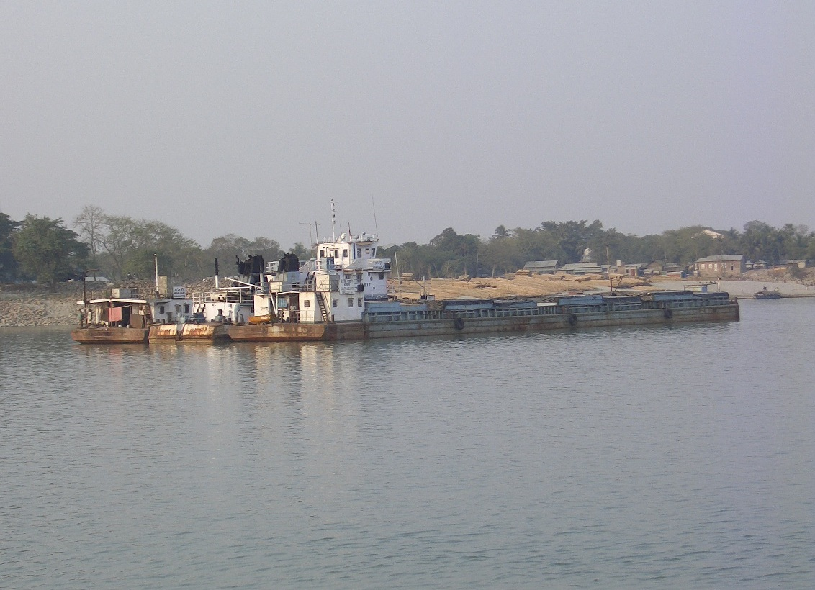
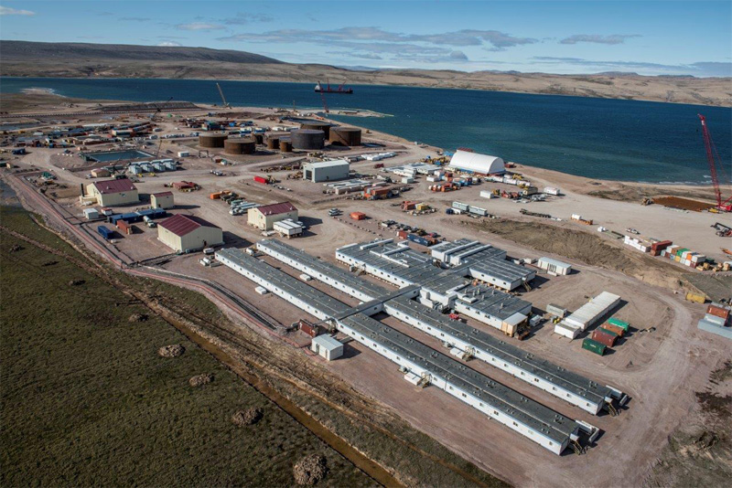
Transformation that we need

Slide 24
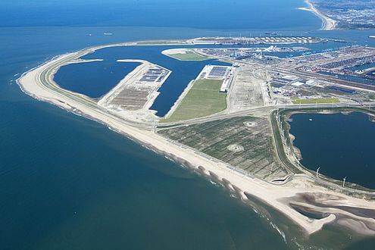
Thank You

