Slide 1
Assam Pilot Project
October 2012

Slide 2
Table of Content
Learning’s from the 10 School Precursor to NVEQF
Key Challenges
Assam NVEQF Pilot Model
Assam Pilot Requirements for 10 Schools
The Public Private Partnership
Preparing for 60 schools
The Road Ahead
Curriculum Development Activities
Team Building Activities
Policy Issues
Immediate Next Steps
Thinking Beyond the Pilot
Appendix

Slide 3
Learning’s from the 10 School Precursor to NVEQF Pilot
Lessons Learned

Slide 4
Key Challenges
Key Challenges
Mitigation Plan
Curriculum approval delays
Infrastructure set up delays
Completion of course within specific timeframe
Low student attendance in some schools
Low student turnover due to holidays
Push back from school principals due to social concerns
Trainer attrition and quality maintenance
Budget overshoot
Student connects and parents connect has to be done several times
Continuous interaction with the Sector Skill Councils and respective state authorities, for curriculum development
Conducting classes during holidays and vacations
Continuous counseling of students and their parents, helping keep motivation levels high
Helping schools authorities with other school related functions, thus keeping the principals and teachers motivated
Maintenance of a bench of trained trainers
Helping the state authorities develop a detailed project plan, underlining the responsibility sharing model
Identified innovative ways to motivate and connect with students and parents.

Slide 5
Assam NVEQF Pilot
Scope – 60 School NVEQF Pilot
Duration – 3 years (2013 – 2016)
Classes – IX, X, XI, XII (NVEQF Levels – 1 to 4)
Trades – Retail and IT Hardware & Networking
Funding – MHRD funded with state government support

Slide 6
Assam Pilot Requirements for 60 Schools As Per MHRD Guidelines
Nature of Expense | Estimates (as per MHRD guidelines)
Number of schools | 60
Number of VE Trades per school | 2
Number of classes with VE (IX till XII) | 4
Number of students per Vocational course per class | 25
Number of students per Class in VE (total of 2 trades) | 50
Total number of students in VE per school | 200
Number of VE Teachers per class per school for both courses | 2
Total number of VE Teachers per school | 8
Total number of VE teachers for all schools | 480
Total number of VE teachers including Backup | 480
Number of lab assistants per school | 0
Number of Vocational Coordinators per school | 2
Total number of Vocational coordinators | 120
Total number of counselors + industry connect for project | 12
Number of Project managers | 6
Time period of project (in years) | 3
Total number of students in VE | 12,000
Master/Expert Vocational Education Teacher | 6
No provision for soft-skills trainer in the MHRD scheme guidelines, that forms the most critical component of such a school based project

Slide 7
Assam Pilot Model As per MHRD Guidelines
Government
Partner
School Selection
Student Mobilization
Infrastructure
School Administration
Teacher Hiring
Teacher Salary
Teacher Training
Course and Curriculum Design and Development
Vocational Coordinators
Any Other
Project Management (only limited cost at 5.5%)
Any Other

Slide 8
The Public Private Partnership The Proposed Model
Government
Partner
School Selection
Communication with Students, Parents, principals and School Administration
Infrastructure
Certification (SEBA and Industry)
Assessments
Industry Association creation and interface
Any Other
Teacher Hiring
Teacher Salary
Teacher Training
Delivery of skills to students
Vocational Coordinators
Course &Curriculum development
Assessment design and delivery
Project Management
Any Other
Industry Partnerships for Employment
As per the proposed PPP model, the Private Partner would take up most of the day to day operational activities, and the Government would pay them for their services

Slide 9
Preparing for 60 Schools
The Road Forward

Slide 10
The Road Ahead
Team Building
Curriculum Development
1X, X, X1, X11 = Rs 7,681,398
Bridge Courses = Rs 5,971,398
24 Vocational Coordinators
Students
Schools
Project managers, Other Support staff
480 Teacher Training
Teacher Hiring
480 Teachers
Assessment &
Certification
Community & Student Mobilization
12000 Students
Set up industry associations
School Admin
Mobilization
60 Schools
Infrastructure

Slide 11
The Road Ahead
Government
Partner
School Selection = 60 (Selected by DSE)
Connects with Students, Parents, Principals
Infrastructure
All sub heads under infrastructure
Infrastructure maintenance
Approx Cost for each school = Rs 8,000,000
(Based on scheme costs for civil and equipment)
Any Other
Certification Cost = Rs 19,937,760
(for 60 schools for 3 years)
Content Creation
Approx Cost = Rs. 13,652,796
Teacher and Support staff salary
Approx Cost = Rs 488,976,000
Teacher Training
Approx Cost = Rs 17,280,000
Course and Curriculum Design and Development
Approx Cost = Rs 13,652,796
Project Management
Approx Cost = Rs 101,700,000
Vocational Coordinators
Approx Cost = Rs 47,520,000
Skills delivery (books etc.)
Approx Cost = Rs 64,094,400
Any Other
Raw Material Cost = Rs 3,600,000
Travel and Office Expenses = Rs 60,399,000
Total Capex = Rs. 480,000,000
Total Opex* = Rs. 23,446,806
Total Capex = 0
Total Opex* = Rs 956,134,330
Total Opex (*incld. Taxes) = Rs 979,581,136
Cost Per Student per year = Rs 27,210

Slide 12
Team Building Activities
Outcome – Program team in place and mobilized by October 30, 2012
Team | Constitution | Responsibilities | Outputs
Core State Team | Education Ministry | Sanction program
 | RMSA | Nodal management and funding | Oversee implementation and proper funding
 | Amtron | Monitor progress, assistance in curriculum development, setup infrastructure | On time infrastructure and curriculum development
 | SEBA/ HS Board | Make necessary changes to academic calendar Endorse curriculum | Updated academic calendar for year 2013
State Voc Coordinator | To be appointed - Jongam Lahkar (option) | Managing communication between different stakeholders | Project implementation and progress as per plan
Program Manager | To be appointed – Pearson Group (best option) | Program Management Develop project plan Manage relationships Monitor progress Send out updates | Project development as per plan
Implementation Partner | To be appointed – IndiaCan (best option) | Workout implementation details Hire and train trainers Implement Project | Project implementation as per plan

Slide 13
Curriculum Development Activities
Function | Details
Who develops | IndiaCan along with Industry Partners and SSCs
Who endorses | State Education Boards and SSCs
Pre-requisites | IT Hardware & Networking industry partners to be selected
Outcome | Curriculum developed and endorsed for implementation
Timeline | Probable date - December 15, 2012
Process to be followed for Curriculum Development –
Trade | Developer | Outcome Definition | Development Partner | Endorser | Comments
IT Hardware & Networking | IndiaCan | Industry Association/ State Chapter of IT SSC | Amtron, Industry Association | State Board | Industry Association to be formed, comprising of industry leaders in IT Hardware & Networking Letters to be sent to Nasscom and MHRD for Industry Asso formation, by Amtron
Retail | IndiaCan | SSC | Amtron | State Board | Development in line with requirements of SSC

Slide 14
Policy Issues
MHRD Policy

Slide 15
Required Changes in Scheme Changes required for a stable PPP based program
There is no clear mechanism for PPP, for involving reputed Vocational Education (VE) providers, nationally reputed companies and industry in general
Public private partnership will work well if broad guidelines are formulated and flexibility given to state to implement the same with a suitable VE provider
Program Items | Current Scheme | Required Changes | Qualitative Benefits | Quantitative Benefits (in 3 yrs)
Policy Scope | MHRD guidelines specifies NVEQF implementation in 11th and 12th only | To be amended to included 9th and 10th into it | * Reduces burden on State Government, to start program from class 9 | NA
Infrastructure | MHRD guidelines are rigid. Limited or no option available to the State to move around costs as per specific project requirements. Also, role of private player is limited | Flexibility, to move costs for purchase of new infrastructure and using existing infrastructure. Also, Private Player should be entrusted with the responsibility to put optimal infrastructure | * Private Player based on the knowledge of the local school system would place optimal infrastructure and also ensure use of existing infrastructure, thus saving costs | Being calculated
Teacher Hiring | Teachers are to be hired by government as government employees and cannot be outsourced to Private Partner | States should be allowed to hire teachers through partners and they should be employed by the Private Partner, as government doesn't have the capacity to hire large number of teachers in a specific vocation | * Private Player would hire and recruit trainers, and place them under strict quality control processes, thus improving over quality of the program | Approx Rs 25 Crore in three years
Teacher Compensation | MHRD has fixed the compensation at Rs 25000 for teachers, without considering local differences in government schools | States should be allowed to define the compensation for the trainers, based on the average compensation provided to general education teachers in high school in the state | * Huge cost saving, that would lead to a surplus, that can be used for other activities like infrastructure development, foreign partnerships, etc

Slide 16
Required Changes in Scheme Changes required for a stable PPP based program
Program Items | Current Scheme | Required Changes | Qualitative Benefits | Quantitative Benefits (in 3 yrs)
Project Mgmt. Costs | MHRD policy does not allow for any project management fees and the administration fees provided is not enough | The project management costs for such a project is around 10% and the current policy needs to be amended to include a separate fees for project management | * Overall quality of delivery would improve, with stronger Project Management rules | Additional Rs 9.5 Crore required, above the approximate Rs 62 Lakhs allotted
Running Costs | MHRD does not comment on who is responsible for it's provision of funding | Running costs like electricity, generator fuel etc should be accounted for in the policy as these are recurring costs | * Clarity on cost sharing necessary for fund allocation, both for the state and the Private Partner | Approx Rs 6.8 Crore required in 3 years
Curriculum Development & Approval | MHRD design does not include either guidelines or funding for creation and validation of content, which is central to the program | Provision need to be made for this, as the current pilot in Assam shows that the cost can be quite high | * Better resource allocation and management from the curriculum developer with availability of allocated funds | Estimates show more than 1crore being spent on this in Assam
Absence of NOS | MHRD design requires the curriculum to be created in line with the NOS and engaging with the SSC’s | In the absence of a NOS and SSC’s the state should be allowed to proceed with setting up an industry association with a group of industries which will act as an SSC | * Faster implementation of trades that are important to specific states
More than Rs.13 Crore extra to be spent by Government in the current setup, that limits the scope of PPP.

Slide 17
Immediate Next Steps
Review and Revise Policy
Clarify Financial Model
Approval to proceed with 60 schools project

Slide 18
Thinking Beyond the Pilot
Possible Model for Sustainability of Program in the long term

Slide 19
Sustainable Future Model
Total Number of Students passing out from class 12 (level 4) = 3000 (50 per school)
Approx No of Students in Retail = 1500
Approx No of Students in IT H&N = 1500
Cost per student = Rs 27,210
Partner Companies for Retail – 10
Partner Companies for IT H&N – 10
Proposed Model
Partner company bears the cost for training a certain number of students, and in return get trained candidates, employable from the 1st day. Thus model becomes sustainable, with the Government freed of the responsibilities of continuously investing in training.
Companies
R1
R2
R3
----------
R10
IT1
IT2
IT3
----------
IT10
Pays
Training
Costs
Sponsor
150 Students
Sponsor
150 Students
Sponsor
150 Students
Sponsor
150 Students
Sponsor
150 Students
Sponsor
150 Students
Sponsor
150 Students
Sponsor
150 Students
----------
----------
Employable
Employees
Gets
Ready
Employees
Gets
Ready
Employees
Gets
Ready
Employees
Gets
Ready
Employees
Gets
Ready
Employees
Gets
Ready
Employees
Gets
Ready
Employees
Gets
Ready
Employees
----------
----------

Slide 20
Appendix
Optimization Models

Slide 21
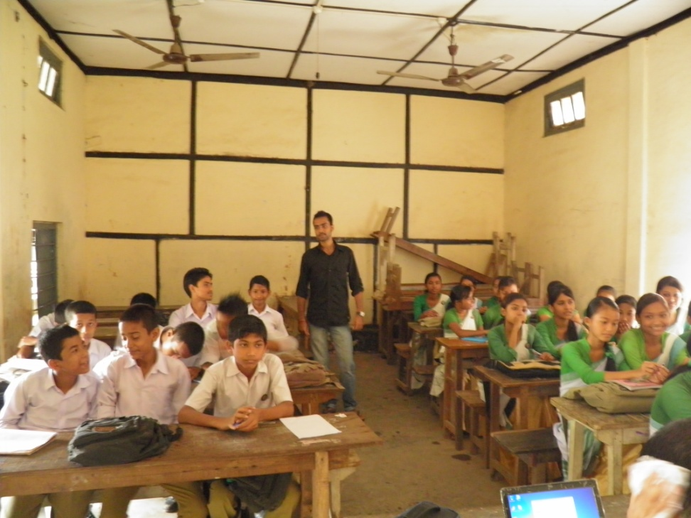
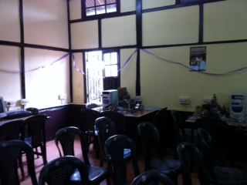
Possible Options for Optimization Infrastructure
Reusing existing infrastructure in Assam like using existing ICT labs and 2 classrooms

Slide 22
Possible Options for Cost reduction and improving quality
By optimizing the number of Teachers and Vocational Coordinators hired per school, significant amount of cost savings can be envisaged
Scheme estimates costs for trainers, vocational coordinators and support staff at Rs. 767,400,000, whereas private partner can provide people costs at Rs. 536,496,000; Cost savings of Rs. 230,904,000
Scheme estimates travel, ………at Rs. 158,400,000, whereas private partner estimate is at Rs. 63,999,000; Cost savings of Rs. 94,401,000
Teacher training as per scheme is mandated to be done through PSSCIVE, where private provider costs are higher to provide better quality of training by Rs. 5,086,400
Books costs as per scheme is fairly low at Rs. 300 per student for one year, whereas private partner books cost (IT – Comptia; English etc.) is higher at Rs. 1500 per student.
Scheme doesn’t have certification costs and project management costs is also low at 5.5% only compared to 10%-13%
Total Cost Savings = 1,077,229,892 – 943,598,049 = 133,631,844
Costs can be further optimized by building flexibility into remuneration structure for teachers

