Slide 1
SYSKA Presentation
February 2017
GST Solutions & Services for the Nation
देश के लिए जीएसटी समस्याओंका हल और सेवाएं
நாட்டின் GST மற்றும் சேவைகள் பிரச்சினைகளை தீர்க்க

Slide 2
The Imperative
GST Will be a Reality Soon…
Key Questions Asked…
GST will be implemented in July 2017
(as per recent Government directive)
What does GST mean for my business?
GST will impact ALL businesses, irrespective of turnover
What do I need to do to become GST compliant?
What is the risk of non-compliance?
Change in input-tax rates will impact exempt businesses as well
Compulsory automation → Intensive reporting → Accounting transparency
What investments, training and capability enhancement do I need?
MSMEs, Tax Administrators and Professionals need a ‘Trusted Partner’ during GST Transition and Beyond…
~46 M MSMEs
~9 M to be transitioned into GST
4M with Desktops
2 M with Internet Connect
0.25 M
Chartered Accountants
0.1 M
Tax Administrator

Slide 3
The Current Scenario
Government
VAT = Output Tax – Input Tax
VAT=8.25– 5.5 = 2.75
Rs.5.5
Rs.2.75
Tax paid during purchase
Indian VAT levied on goods separately for different state. Eg. LED light in Maharashtra
Tax paid on output
Sale of Rs. 100
Sale of Rs. 150
VAT @5.5%`
Supplier
Manufacturer
Purchase cost
=
80
Purchase cost
=
100
Value Addition
=
20
Value Addition
=
50
Selling cost
=
100
Selling cost
=
150
VAT collected from distributor
=
5.5
VAT collected from distributor
=
8.25

Slide 4
The GST Scenario - When Supplier has paid tax on materials/ inputs
Input Credit=3
GSTN
Rs.6
Rs.3
Tax paid
Tax on output
Sale of Rs. 100
GST@6%
Supplier
Manufacturer
Raw Material cost
=
80
Purchase cost
=
100
Profit Margin
=
20
Value Addition
=
50
Total
=
100
Selling cost
=
150

Slide 5
The GST Scenario - When Supplier has not paid tax on materials/ inputs
No Input Credit
Rs.6
GSTN
Rs.9
Tax not paid
Tax on output
Sale of Rs. 100
GST@6%
Supplier
Manufacturer
Raw Material cost
=
80
Purchase cost
=
100
Profit Margin
=
20
Value Addition
=
50
Total
=
100
Selling cost
=
150

Slide 6
Adhigam GST Solution
Nodal / MSMEs / CAs
IT platform based delivery
Subscription
Financial Assessment
Legal Analysis
GST Compliance
Training
Direct interaction (Compliance Support)
Helpline Support
Strong Project Management teams
Direct interaction (specific services)
IT Platform
In-house Teams
Technical partnerships for quick scale-up
Legal Experts
Domain Expert
Accounting Solutions
IT Systems
Customer Support
Tax Professionals
Ex-Govt. Officials
GSP
ASP
Panel of Experts
Outsourcing Partners
Technology Partners

Slide 7
Adhigam Offerings
Product Features
1
GST Training
Online courses by domain experts in multi-regional languages
Services for all GST needs
No additional investment - Works with existing systems & data
2
Financial Analysis
Comprehensive assessment of financial and compliance impact on your business
Simple, intuitive interface & easy to use
3
Compliance
100% automated process from registration, ERP integration, reconciliation to GSTN filing
No additional skill or understanding required
4
Legal Analysis
Simplified explanation & interpretation of the GST law & queries by connecting to lawyers and through AI based systems
Specific to industry & business sectors
5
Finance
Real-time and easy short term finance options for business needs
Data is secure & confidential
- Multi-language options
- Helpline Support

Slide 8
Our Key Differentiators
Simplified and Digitised GST compliance solution
Focused solutions designed and contextual to MSME segment
Industry specific solutions designed by Sector and Tax experts
Integrated and evolving offering product suite centred on GST compliance
‘Anywhere-Anyhow-Anytime’ accessibility through secure and scalable IT platform
Highly secure and scalable solution
Affordable pricing

Slide 9
GST Transition
Transition Challenges
Our Solutions
Lack of knowledge of GST ‘Rules’ and ‘Compliance’ requirements
Comprehensive sector specific GST legal analysis
No customisation of existing IT systems required
Absence of internal IT capacity to customise existing IT systems
GST compliance solution provisioned through ‘as a Service’ without upfront investment
Limited resources to procure new IT systems for GST compliance
Inability to recruit GST trained staff or qualified service providers
Simplified and digitised workflows obviate need for GST trained staff to use system
Most of GST transition solutions available are without sector specific nuances
Sector specific solutions designed by sector experts

Slide 10
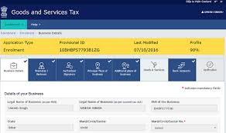
ASP-GSP Ecosystem
GSTN Portal
Internet
GSPs
Internet
ASPs
as ASP
Internet
MSMEs

Slide 11
Invoice Generation Flow
Select transaction
Identify if Goods or Service
Classify Tax and Rate from Product & Rate masters
Computation of Tax
Identify point of taxation
Identify Place of supply from Rules master
Prepare invoice
Post invoice to Books & Records
Print invoice

Slide 12
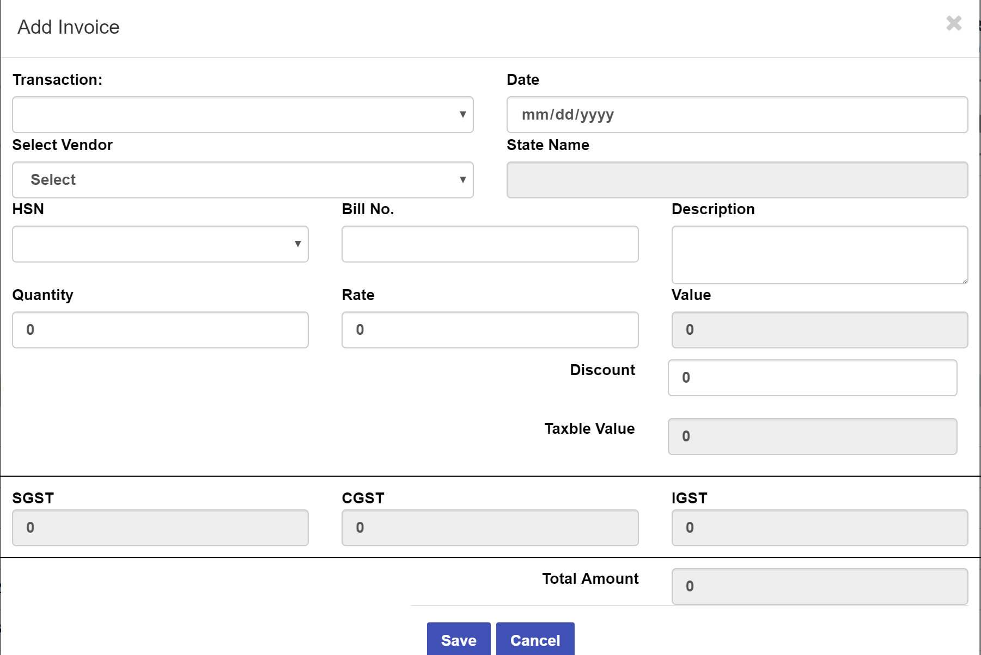
Invoice Generation - Screen

Slide 13
Compliance Flow
1
Accounting Transaction Upload/Creation
2
Categorization of Sales/Purchase Invoice
3
Auto Populate GSTR1
(10th of each month)
4
Approval of GSTR1 form by CA & Business Owner
5
Digital signature & Filing of GSTR1
6
Download GSTR 2A
7
Approval/Rejection & Additional Transaction details to be validated
8
Auto populate GSTR 2 based on transaction details
9
Download GSTR1A
10
Approval / Rejection of Transaction details from 1A.
11
Filing of GSTR2
(15th Of each month)
12
Reconciliation & Preparation of GSTR 3
13
Computation of Tax Liability
14
Digital Signature, Payment along with GSTR 3
(20th of each month)

Slide 14
Thank You!
Q & A

Slide 15
Back up

Slide 16
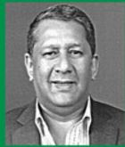
Founders
S. Ramadorai
Ranjit Barthakur
Rohan Shah
Positions & Roles
CEO TCS b/w 1996 and 2009
Chairman: BSE¹ , Tata Technologies Ltd, Tata Elxi, etc.
Board of directors: HUL Ltd.² , Nicholas Piramal Indian Ltd.
Awards & recognitions
Padma Bhushan, 2006
Business India's "Business Man of the Year”, 2003
Others: Lifetime Achievement Award(IMA ³ ), Distinguished Achievement Award (IISC⁴ Bangalore), etc.
Positions & Roles
Chairman and Director: Amalgamated Plantations
30 years experience in leading & managing companies across FMCG, tele-communications, tourism, technology, outsourcing and healthcare
Economic and Investment Advisor to the Chief Minister of Assam
Advisor to the Board and management: Max Healthcare, Anand Group, Airtel
Positions & Roles
Tax Counsel practicing in High Courts and Supreme Court
Client representations before Hon’ble Supreme Court in areas of indirect tax and trade remedial disputes
Appointment to Expert committees by Indian Ministry of Finance and the Indian Ministry of Commerce
Listed leading lawyer (tax) by: Asia Pacific Legal 500 and Chambers Asia-Pacific from 2005 till 2013, Asialaw Leading Laywers 2013, etc.

